Slide 1
Mgbebu Tochukwu .A. Mouau/CMP/18/102478 Technical Report Defense

Slide 2
INTRODUCTION

Slide 3
Brief History of SIWES
Objectives of SIWES
Provide an avenue fro students in Institutions of higher learning to acquire industrial skills and experience in their respective courses of study.
Prepare students for the industrial work situation they are likely to experience after graduation.
Expose students to work methods and techniques of handling equipment and machinery that may not be available in their institutions.
Make the transition from school to the world of work easier; and enhance students’ networks for later job placements.
Provide students with an opportunity to apply their knowledge to real work situations, therby bridging the gap between theory and practice; and
Enlist and strengthen employers’ involvement in the entire educational process; thereby preparing the students for employment in industry and commerce.

Slide 4
Company of Establishment

Slide 5
Directorate of Information and Communication Technology (DICT)
History
Vision
Mission
Objectives
Organogram

Slide 6
Directorate of Information and Communication Technology (DICT)
History

Slide 7
Directorate of Information and Communication Technology (DICT)
Vision:
The vision is to exploit ICT to its full potential thereby assisting the University in elevating its position to a center of academic excellence.

Slide 8
Directorate of Information and Communication Technology (DICT)
Mission:
Our mission is to integrate ICT in all aspects of Teaching, Learning, Research and Community Development endeavors by providing, coordinating and facilitating the use of ICT in all activities of the university in order to accelerate change.
We strive to abide by the virtues of integrity, honesty and meritocracy in all our activities.
We embrace excellence, efficiency and effectiveness.
We endeavor to carry out our duties with commitment, dedication and professionalism.

Slide 9
Directorate of Information and Communication Technology (DICT)
Objectives:
Planning, developing and managing University-wide ICT infrastructure.
Developing and/or acquiring relevant applications and solutions.
Managing operations and maintenance of ICT resources.
Training end-users on computer literacy and offering end-user computing support.

Slide 10
Directorate of Information and Communication Technology (DICT)
Vice-chancellor
ICT Commitee(Advisory)
ICT Director
Network Management Unit
(NMU)
Management Information Unit
(MIU)
Maintenance and Facility Unit
(MFU)
1. Hardware maintenance team.
2. Software maintenance team.
3. Store and inventory team
1. Network Management Services
2. Internet and Intranet Services.
3. GIS Security Services
Support and Services Unit
(SSU)
Training Unit
(TU)
E-learning Technologist Unit
(ETU)
Data Storage and Advertising Unit
(DSAU)
1. Web operational team.
2. Software application developement team.
3. Data entry team
1. NGREM support services
2. IT services support team.
3. Help desk officers
Staff training team
1. Video conferencing team.
2. Digital library team.
1. Advert and marketing.
2. Data management system.
Company Organogram:

Slide 11
Experience Gained

Slide 12
How to load an OS into a crashed computer, especially one that occurred due a high power voltage

Slide 13
Learning about drivers and the system utility software

Slide 14
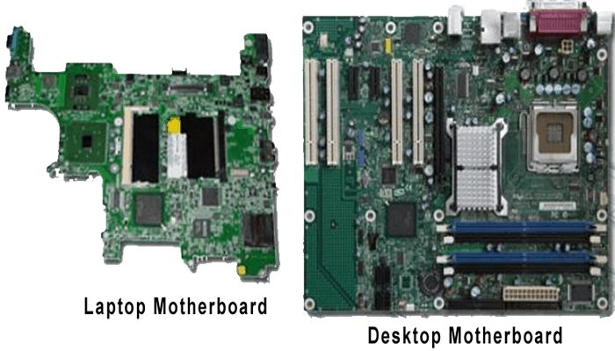
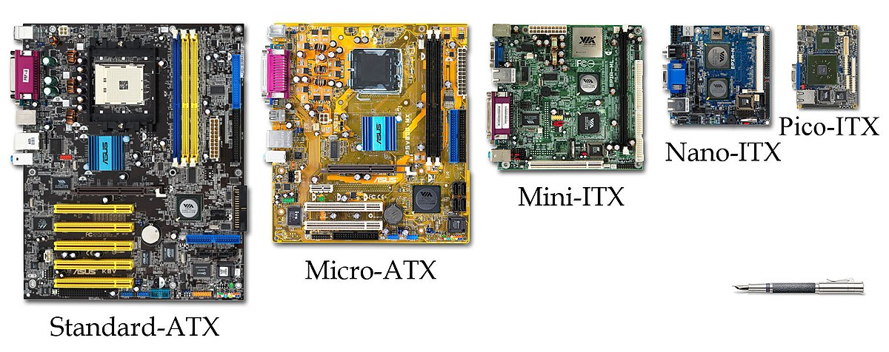
How to assemble and disassemble a computer and what the different components represent.
Motherboard Form-factors

Slide 15
Learning how to work with the BIOS/UEFI

Slide 16
Real work scenario of a computer repair and maintenance specialist.

Slide 17
Correct buying behavior when it comes to purchasing a computer.

Slide 18
Conclusion

Slide 19
Thank You !!! ❤❤❤

